Slide 1
Plainview ISD Supplemental Benefits
Full plan descriptions and brochures can be found at
http://www.benefits.ffga.com/plainviewisd

Slide 2
How do I enroll?
Please visit http://www.benefits.ffga.com/plainviewisd and click the “How to Enroll” option at the top of the page. This site will also provide you with helpful resources, brochures, contact information and important updates to PISD’s benefit plans.

Slide 3
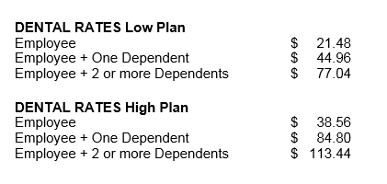
Dental Insurance
Dual plan option available. (High or Low option)
High Plan pays out $1,500 per covered person, each calendar year.
Low Plan pays out $750 per covered person, each calendar year.
New for 2018-2019; deductible increased from $50 to $75, beginning 09/01.

Slide 4
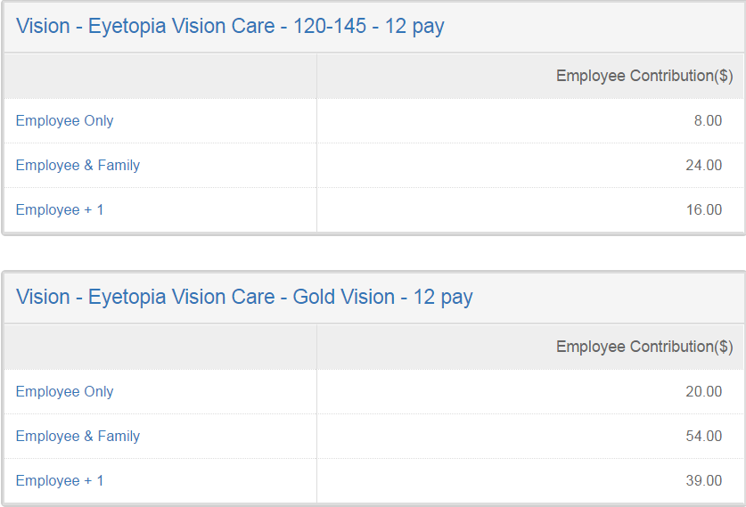
Vision Insurance
Dual plan design available. (high or low coverage)
Pays up to $500 per eye for LASIK surgery.
Must utilize Eyetopia network doctors. No out of network coverage available. (provider information can be found at http://www.eyetopia.org)

Slide 5
Vision Insurance -
Dual plan design available. (high or low plan coverage)
Larger network and allows for both in or out of network benefits. (provider list located at https://www.superiorvision.com/Member/locate_provider - select the Superior National network.

Slide 6
Flexible Spending Plans
Medical Flexible Spending Accounts allows you to use “pre-tax” dollars for IRS qualified, out-of-pocket medical expenses. (IRS approved items, and other useful information, can be found at www.ffga.com)
100% of annual election available on 09/01/2017.
Debit cards, online and mobile app account management, now available.
New IRS maximum of $2,600 for 2017-2018 plan year. (beginning 09/01/2017)
Dependent Care Flexible Spending Accounts allows you to use “pre-tax” dollars for IRS qualified, out-of-pocket daycare costs.
Dependent daycare expenses are eligible if the care is for your dependent child, under age 13, or for dependent adults unable to care for themselves.
IRS maximum election is $5,000 annually.
This account in NOT pre-funded like a FSA account. Only the money you have contributed is available.

Slide 7
Disability Insurance
Provides a cost effective solution from financial hardship should you become disabled due to a covered pregnancy, illness or accident.
You can elect up to 70% of your gross monthly income.
Flexible elimination periods available (14, 30, 60, 90 or 150 days) to fit your needs.
Features also include waiver of premium, return to work and accidental death benefit.
All eligible benefits paid directly to you.

Slide 8
Permanent Life Insurance
Designed to be in force when you die, this voluntary universal life product is yours to keep, even when you change jobs or retire, as long as you pay the premium.
You may apply for this permanent, portable coverage, not only for yourself, but also for your spouse, and minor children and grandchildren.
“Express Issue” coverage available to eligible employees and family members. (just 3 easy medical questions!)

Slide 9
Hospital Indemnity Plan
Multiple plan designs available to fit your budget and coverage needs.
You'll be reimbursed a specified amount (depending on the plan you select) for covered hospital confinement, physical exams, and doctor's office visits. Benefits are paid directly to you, and you can use the cash however you want.

Slide 10
Cancer Insurance
A cancer diagnosis can be devastating, both personally and financially. It is likely that your major medical coverage will not cover all of the costs associated with a cancer diagnosis. Supplementing your major medical with cancer insurance may help you pay for related expenses, such as copays and deductibles, child care, travel costs, experimental treatment, help at home or specialty hospitals.
With cancer insurance, benefits are paid to you, so you choose how to spend them.
You may keep your cancer plan at retirement or separation of service, as long as you continue to pay the required premium.
Plans pay an annual wellness benefit for those covered, so don’t forget to submit your claim form to Allstate! (claim forms can be found at http://www.benefits.ffga.com/plainviewisd)

Slide 11
Accident Insurance
This plan provides 24-hour coverage for accidents that occur both on and off the job. With more than 25 available benefits, this plan pays for a wide range of benefits and can help offset the financial cost of medical expenses.
All payments are made directly to you.
Four coverage options to pick from to suit your lifestyle and financial needs.
Plan pays 1 wellness benefit per year. Claim forms found at http://www.benefits.ffga.com/plainviewisd

Slide 12
Critical Illness Insurance
This benefit is designed to protect you, your family and your assets in the event of a critical illness.
Benefits payments are made directly to you and can help cover expenses such as out-of-pocket medical care costs, home health care and rehabilitation.
Humana pays a lump sum indemnity, in the event of a covered claim.
Multiple plans available to fit your financial needs.

Slide 13
Telemedicine
Get treated without leaving your home or office. Members get access to a national network of U.S. board-certified doctors and pediatricians, 24 hours a day/7 days a week via phone, video, or online.
When Should You Use Your MyHealthPass Benefits?
After your physician’s normal hours of operation
If you are on vacation, business trip or away from home
If you need a short-term prescription refilled
If you would like guidance on the type of specialist you should see or if you have a health related question
If you are thinking about visiting the emergency room for a non-emergency medical issue

Slide 14
Group Term Life Insurance
Group life insurance allows you to purchase affordable life insurance on yourself, spouse and dependent children. This is term insurance, available as long as you are an employee with the District.
Low cost term life insurance
Rates are based on your age and will increase in five year increments.
New employees can apply for up to the guarantee issue amount without answering health questions
No cash value accumulates
Spouse and Dependent Child(ren) can also apply
Employees enrolling for coverage after the first 31 days of their employment, will be subject to insurability and must complete a health questionnaire prior to coverage being issued.

Slide 15
Identity Theft and Pre-Paid Legal
Pre-paid Legal - LegalShield
Everyone deserves equal access to the justice system and now with LegalShield, everyone can have it! From the trivial to the traumatic, LegalShield helps protect your rights so you can worry less and live more!
Identity Theft Protection – IDShield
Your personal information now lives online. Sharing an email address or even a credit card number is part of everyday life, but more than ever, this makes you vulnerable to thieves.
Enroll today in identity protection services to diligently monitor for signs of criminal activity and get all you need to keep your identity secure from thieves and fraud.

Slide 16
MASA – Medical Transport Solutions *NEW*
Be prepared for the unexpected with a MASA membership. No matter where you live, you could have access to vital emergency medical transportation for a minimal monthly fee. That membership could one day save your life, and, every day, it will give you peace of mind like nothing else.
One low fee for peace of mind for emergent transport costs
No deductibles
Easy claim process
No health questions
Anyone can join

